Slide 1

Dr. D. Y. Patil Institute of Technology, Pimpri, Pune
Department of Artificial Intelligence and Technology
A Project Presentation for the Degree Bachelor in Artificial Intelligence and Data Science
Smart Shopping Cart With Automatic Pricing, Product Information and Recommendation System
P roject Group Member Details
Sr. No | Exam Seat No | Name of Student
1 | B190242033 | Gautami kadam
2 | B190242034 | Saurabh Kale
3 | B190242046 | Pranav Mule
4 | B190242062 | Jay Sawant
Project Guide Name | Ms. Jyotsna Barpute
Designation | Assistant Professor
Domain | IOT, App Development,
AY 2023-24 SEM-II <number>

Slide 2
Table of Contents
Introduction
Literature Survey
Gap finding from literature review
Motivation
Problem Statement
Scope & Objective
System Architecture
Algorithm/Methods
Result Discussion (with Table and Graphs)
Conclusion
Future Work
References
Paper Publication
IPR
AY 2023-24 SEM-II <number>

Slide 3
Introduction
Over the past few years, IOT has become one of the most important technologies of the 21st century.
Now that we can connect everyday objects kitchen appliances, cars, thermostats, baby monitors to the internet via embedded devices, seamless communication is possible between people, processes, and things.
Nowadays, buying and searching at huge malls is turning into a daily activity in subway cities.
We can see large rush at malls on holidays and weekends.
The rush is even a lot of once there are special offers and discount.
To minimize the Queue at a billing counter in a shopping complex.
Smart Trolley does the same by displaying the total price of the product kept inside the cart.
Recommendation of clothes will be shown on android app.
Collaborative filtering algorithm will be used for recommendation.
AY 2023-24 SEM-II <number>

Slide 4
Literature Survey
Name of Author | Year | Title | Description | Gap identified
Vaibhav Tyagi | 2021 | Smart Trolley | Product weight and product quantity will be displayed, with price details. Smart Shopping Cart | Bill is not generated. Users have to wait in queue for billing.
Mobeen Shahroz | 2020 | IoT-Based Smart Shopping Cart Using Radio Frequency Identification | It has an RFID reader which scans the product which has an RFID tag in it. The billing is done in the queue. | This doesn't generate a bill and the price is not shown on screen.
Sushi and Zhang | 2019 | Smart Trolley using Arduino UNO | will generate the shopping bill in the shopping cart itself with the help of an RFID reader. Smart Cart with Automatic Billing | The addition of products is possible, but if you remove the product price will not be changed.

Slide 5
Gap Finding from Literature Review
Name of Author | Year | Title | Description | Gap identified
S Kowshika | 2021 | IoT based Smart Shopping Trolley with Mobile Cart Application | With the use of this mobile application and trolley, customer can make bill payment in no time | Connection require internet. There might be possibility some user can face range issue.
Chandrasekar Palanisami | 2020 | Smart Cart with Automatic Billing | In this paper they have made a system model where each cart will have an RFID reader and zigbee trans-receiver implemented on it. | System Does not provide any recommendation
Dr. Subburam, Anitha R | 2019 | Smart trolley and billing system | The smart cart uses the RFID tag and receiver to scan the product, load cell to prevent theft, LCD display and the Raspberry pi. | Product cost is more as raspberry pi is used.

Slide 6
Gap Finding from Literature Review
Name of Author | Year | Title | Description | Gap identified
S. Ganesh Sundaram | 2022 | Collaborative Product Recommendation System for E-commerce Websites | The online patron score are completely based on every patron real enjoy which could comprise significant and greater person-orientated information | only a few merchandise is advocated to the person by means of making use of person-supplied filtering capabilities and suggested single five-scale score..
Arpit Jain | 2022 | Secure and Smart Trolley Shopping System based on IoT | As an additional benefit, inventory management may be simplified because all commodities can be automatically read by an RFID reader rather than being manually scanned. | System Does not provide any recommendation
Anitta D | 2021 | Smart Shopping Cart using IOT and robotic arm | Wherein RFID tags are used for recognition of item, RFID reader which is pre-owned for scanning of goods and robotic arm to place products in the trolley this helps the disabled people who are unable to pick and scan of products and details are displayed on the LCD, and the customer can do the payment in their hand itself without waiting in the long queue. | Product cost is more as raspberry pi is used.

Slide 7
Motivation
Even through e-commence and other online applications are growing rapidly the craze for traditional shopping has never stepped back.
One difficulty is to follow up in a queue for the billing process. There, arises a demand for easy and quick payment of bills.
The proposed Smart Cart, is capable of generating bill using IoT along with the mobile cart application having cloth recommendation.
AY 2023-24 SEM-II <number>

Slide 8
Problem Statement
Shopping mall is a place where most people from all walks of life will get their daily necessities ranging from food product, apparels, toiletries, gardening tools electrical appliances, and others.
Since the entire process of billing is manual it increase the possibility of human error substantially and time is also increased.
Hence to overcome this problem we are creating a smart cart system.
AY 2023-24 SEM-II <number>

Slide 9
Scope and Objectives
The project aims at the billing automation of purchased products using Smart Shopping cart to minimize the time spent for scanning each product manually using RFID Scanners with recommendation systems to enhance the customer’s experience at supermarkets and hypermarkets.
Smart shopping cart system that will keep the track of purchased products and also online transaction for billing using RFID and also provides recommendation for certain product category
AY 2023-24 SEM-II <number>

Slide 10
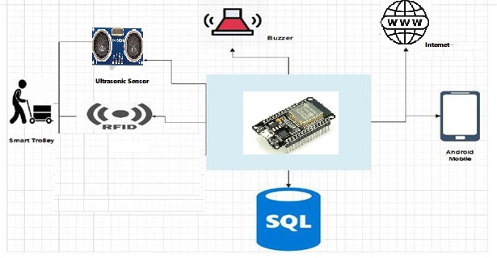
System Architecture
AY 2023-24 SEM-II <number>

Slide 11
Algorithms/ Method
Step 1: Finding similarities of all the item pairs.
Form the item pairs. For example in this example the item pairs are (Item_1, Item_2), (Item_1, Item_3), and (Item_2, Item_3). Select each item to pair one by one.
Step 2:Predicting Products
After this, we find all the users who have purchased for both the items in the item pair. Form a vector for each item and calculate the similarity between the two items using the cosine formula
AY 2023-24 SEM-II <number>

Slide 12
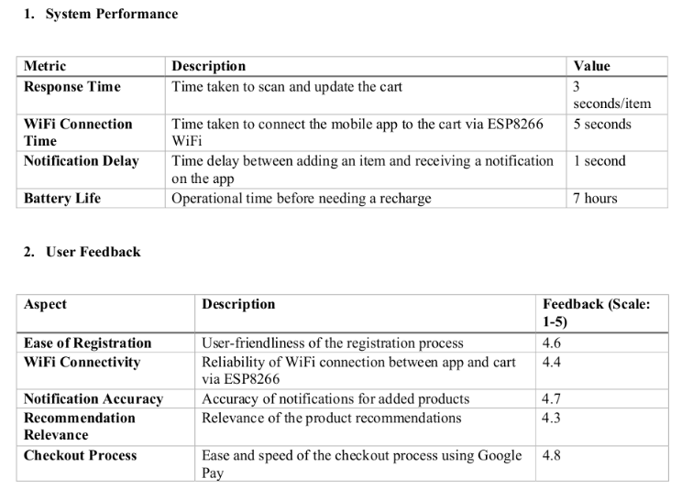
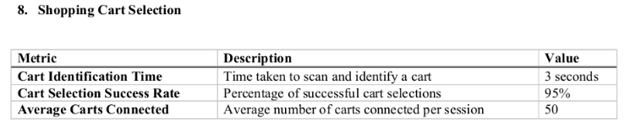
Result Discussion
AY 2023-24 SEM-II <number>

Slide 13
Conclusion
The project designed is based on the working of a smart shopping trolley, which works in such a manner that the customer needs to just lead the trolley and the trolley will automatically generate bill and recommend product the customer.
The integration of wireless technologies with smart carts can make shopping more convenient for customers, and mobile payment options can reduce the time spent waiting in long queues
AY 2023-24 SEM-II <number>

Slide 14
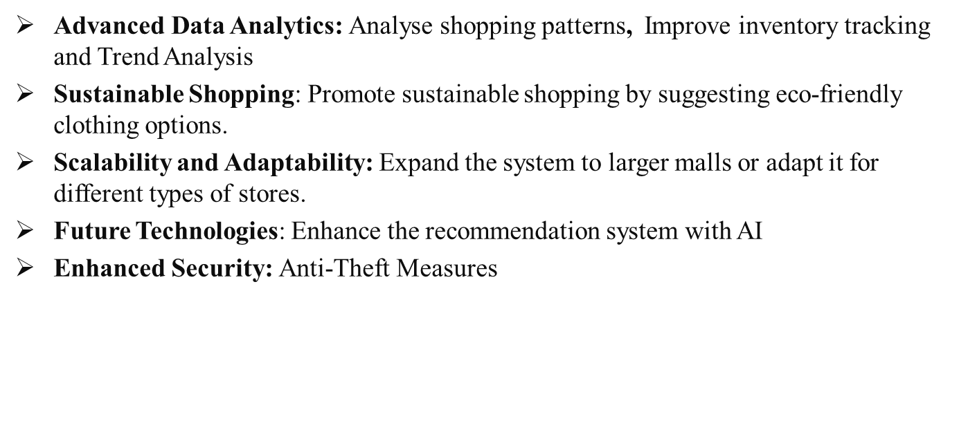
Future Work
AY 2023-24 SEM-II <number>

Slide 15
References
[1] Mr. Manikandan and Mr. Mohan "RFID Based Shopping Trolley for Supermarket", JCHPS,8 June 2022.
[2] Mr. S. Balamurugan and Mr. S. Balaji "Smart Shopping Cart", International Conference on Microelectronic Devices, Circuits, and Systems (ICMDCS) 10-12 August 2021
[3] Mr Kumar and Mr Gupta. A “Smart Trolley using Arduino”, International Journal of Advanced Research in Computer Engineering & Technology (IJARCET),12 December 2020.
[4] R.O’ Neil “Smart trolley for shopping malls”. European Journal of Molecular & Clinical Medicine, November 2020
AY 2023-24 SEM-II <number>

Slide 16
References
[5] Mr. Inamdar, Mr Singh “Smart cart using automatic billing, product information, product recommendation using RFID,2015.
[6] Mr. P. Chandrasekar and Ms. T. Sangeetha "Smart shopping cart with automatic billing system through RFID and transmitter and receiver", IEEE, 2014.
[7] Leena Thomas, Renu Mary George “Smart Trolley with Advanced Billing System” International Journal of Advanced Research in Electrical, 3, March 2017
AY 2023-24 SEM-II <number>

Slide 17
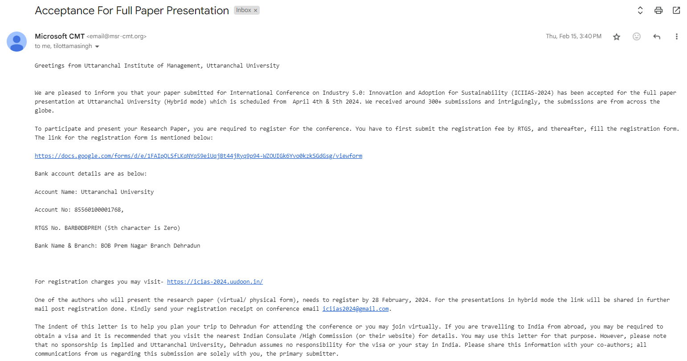
Paper Publication Details
AY 2023-24 SEM-II <number>

Slide 18
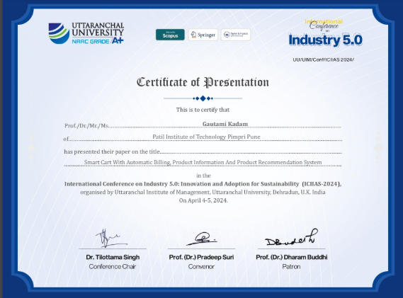
Paper Publication Details
AY 2023-24 SEM-II <number>

Slide 19
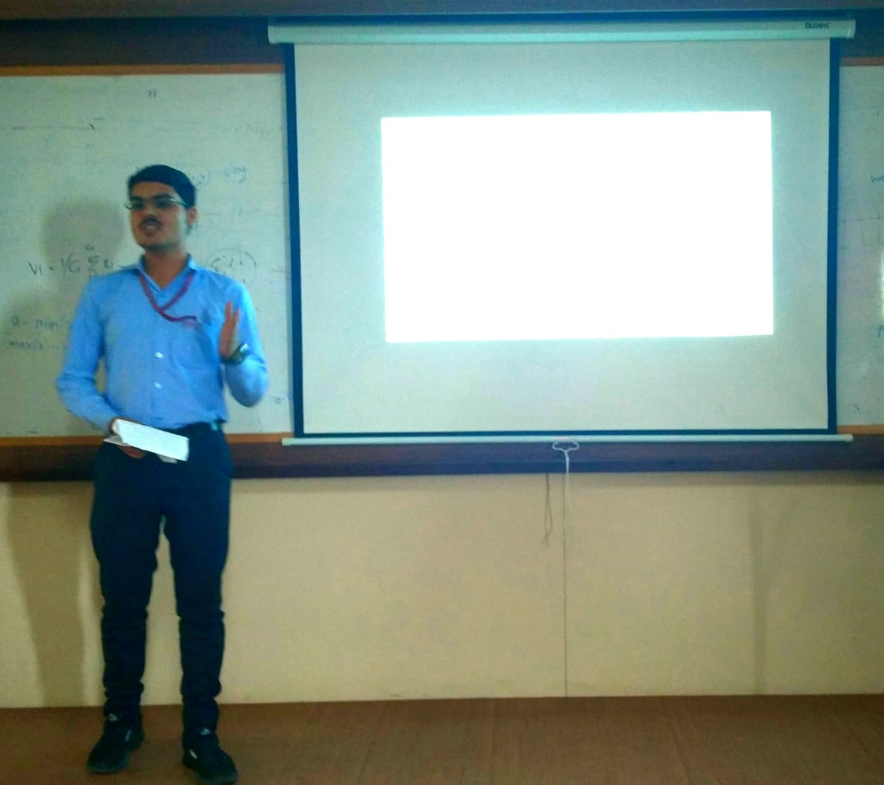
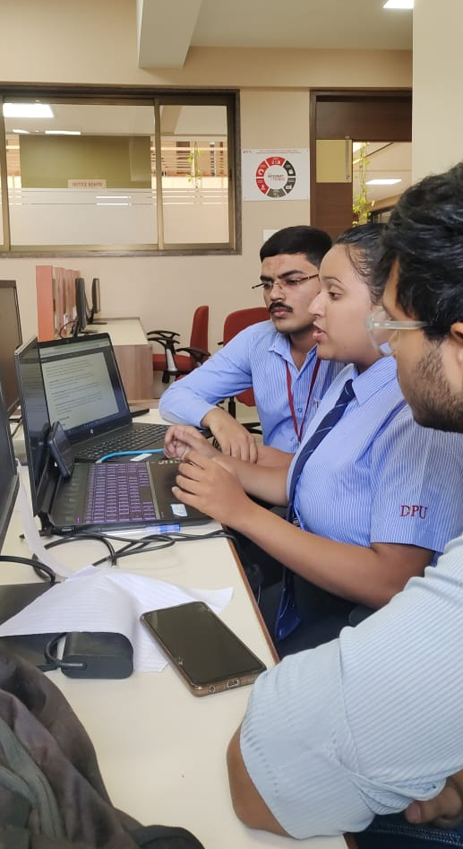

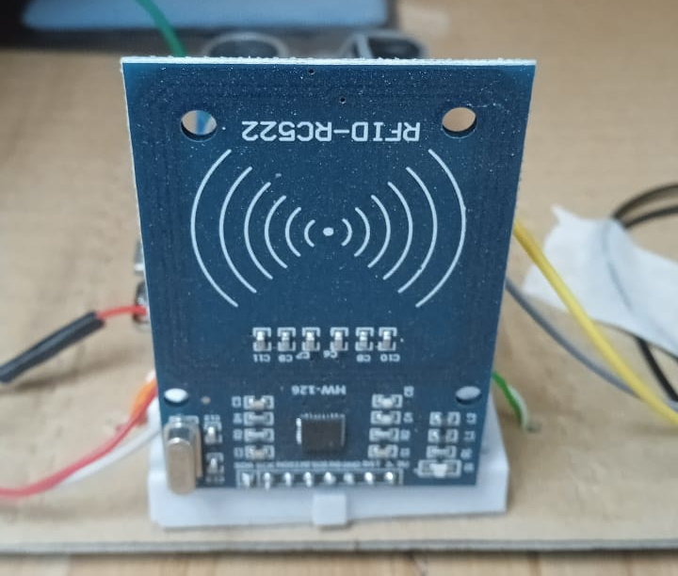
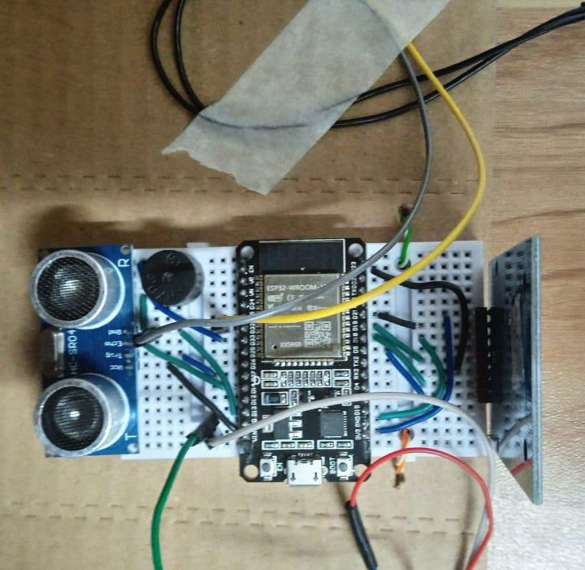
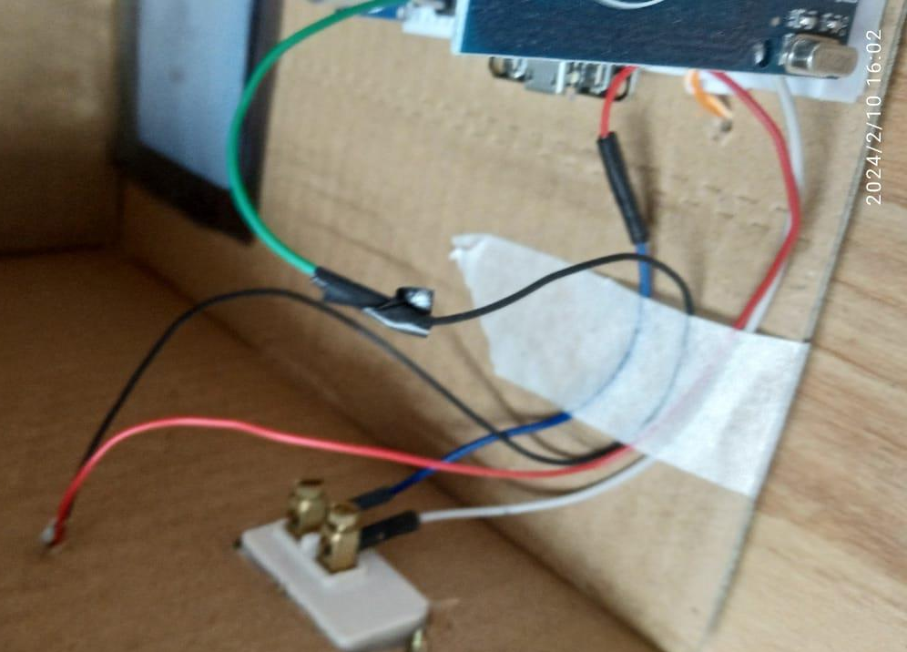
Some Glimpses of Project Work:
Review Presentations
ICIIAS-2024 Conference Paper Publication Presentation
Project Implementation
Project Discussions

